Slide 1

Project title : Testing the functionality of Luma e-commerce application Using selenium
Software Tool : Selenium Webdriver
By
G.yuvanraja

Slide 2
Types of Web Application Testing Tool
Selenium
Katalon Studio
CasperJS
Screenster
SoapUI
Sahi
Watin
Watir
QTP (UFT)
10.Lambda test

Slide 3
Why Selenium Tool?
Selenium is one of the most widely used open source Web UI (User Interface) automation testing suite
Selnium used for testing web browser it is used to test all web application present in the browser
Selenium supports various operating systems, browsers and programming languages. Following is the list:
Programming Languages: C#, Java, Python, PHP, Ruby, Perl, and JavaScript
Operating Systems: Android, iOS, Windows, Linux, Mac, Solaris.
Browsers: Google Chrome, Mozilla Firefox, Internet Explorer, Edge, Opera, Safari, etc.

Slide 4
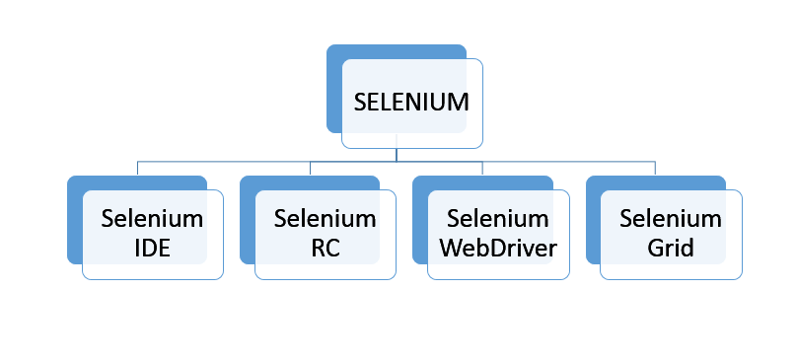
Selenium Components

Slide 5
Selenium Webdriver
Selenium Webdriver can support multiple languages like Java, Python, JavaScript, C# and so on.
Selenium Webdriver can be used to test an application in multiple browsers like Chrome, Firefox, Safari, IE
Selenium Webdriver can be used to stimulate human-like actions like drag and drop, keypress, click and hold, and so on.
Selenium Webdriver has the ability to test more than one device like Android, Blackberry, and iPhones
The Selenium Webdriver tool is used for automating web application testing to verify that it works as expected or not

Slide 6
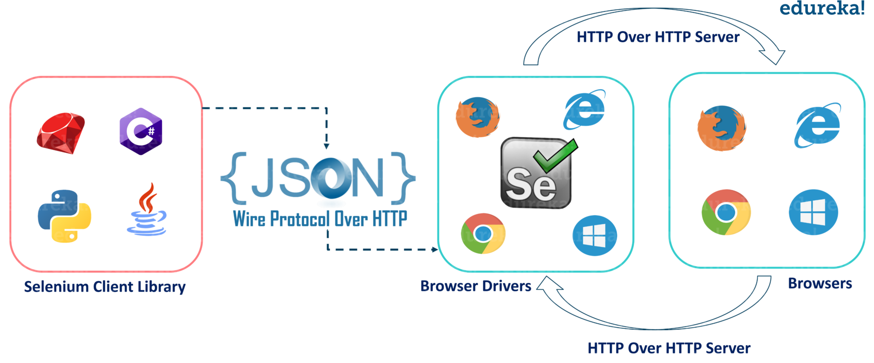
Selenium Architecture

Slide 7
Project Introduction
In this project I have mentioned about what are the methods and commands used for testing the e commerce application
By using selenium Webdriver we can test the application on user point of view
In this project I have tested the e commerce application basic functionality like purchasing a product, search any product in the search icon and sign
I have mentioned about What are the benefits and difficulties faced while using the selenium software
Test case and test Scenario I have mentioned in the project

Slide 8
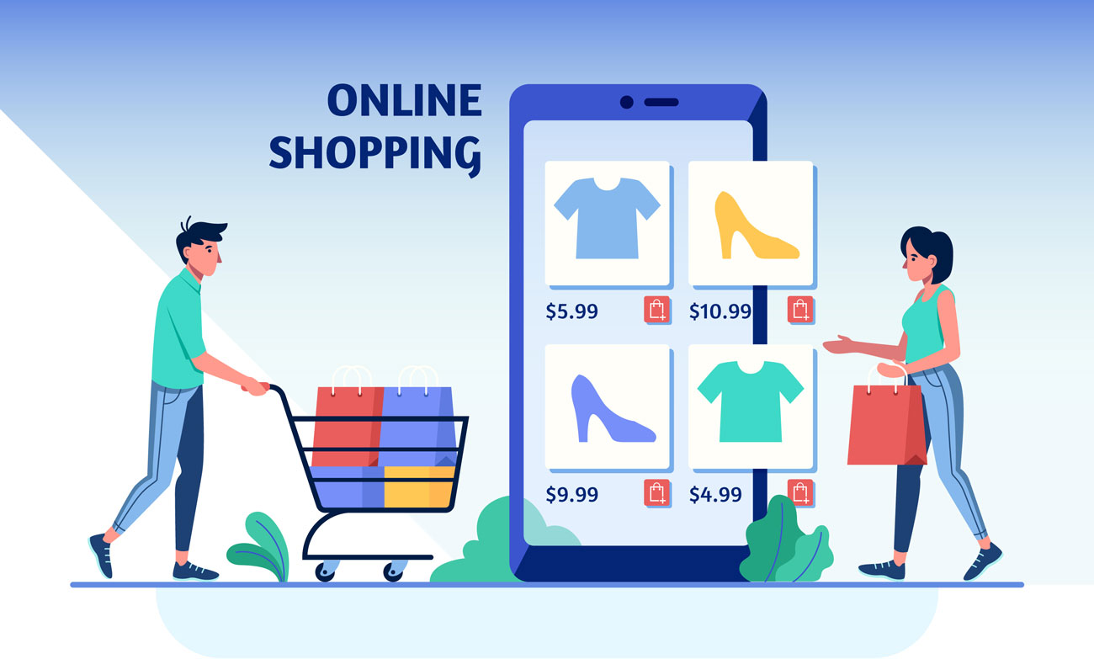
Why e-commerce application?
E-commerce (electronic commerce) is the activity of electronically buying or selling of products on online services or over the Internet.
E-commerce application most of the user are using in this world

Slide 9
Defects user facing
In e-commerce website after entering password and username sometimes user couldn’t login
Searching result may not shown after selecting a search icon
Add to cart option is not properly working
Some times user will not get the confirmation message
User try to cancel the order but misalignment or missing information in the chatbot
When user enters valid credential values in payment part but sometimes it may show payment failed
User not able to track a product

Slide 10
Modules used in project
Sign-in module
To check user able to sign-in the application by entering the credential values in User name and password text box
Search a product name
To check user able to search a product name in the search icon after selecting search icon user gets the result or not
Confirmation message
To check user able to receive the confirmation message or not after purchasing a product

Slide 11
Types of commands
Browser commands
Navigation commands
Web element commands
Browser commands:
All the commands are associated with browser is known as browser commands
Navigation commands:
By using the navigation commands we can check the browser moments
Web element commands:
List of action that can be performed on various web elements

Slide 12
Methods Used in project
find element();
get method();
isEnabled();
sendkeys();
sleep();
executeScript();
back();
quit();

Slide 13
Find element
The selenium find element is the command that is used to identify a web element within a web page in a unique way, and it returns the first matching web element;
It contains any set of web locator elements using id and name we can pass the data's to identified the data's with default methods
like find Element() with default parameters like find Element(By.id(<element ID)) and find Element(By.name(<element-name)) for each set of commands

Slide 14
Element visibility
isEnabled
isSelected
isDisplayed
isEnabled method
isEnabled method is used to test the web element is present on the web page or not
Boolean FirstName= driver.findElement(By.id("fname")).isEnabled(); System.out.print(FirstName);

Slide 15
Sendkeys Method
Identifying the input fields using specific locators. For example, an email address, password field.
Entering values in input boxes explicitly using sendkeys() method
Syntax for sendkeys
Web Element email = driver.findElement(By.id("user email"));
email.sendKeys("---your email id---")

Slide 16
Sleep method
Thread Class is a class that is basically a thread of execution of the programs. It is present in java.lang.package
The sleep() method is used to stop the execution of the current thread(whichever might be executing in the system) for a specific duration of the time and
After that time duration gets over, the thread which is executing earlier starts to execute again
It does not return any value, i.e., the return type of the sleep function is void.
Millis: Duration of time in milliseconds for which thread will sleep

Slide 17
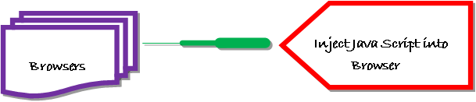
JavaScript executor
JavaScript Executor is an Interface that helps to execute java script through selenium Webdriver
JavaScript Executor provides two methods “executeScript” & “executeAsyncScript” to run JavaScript on the selected window or current page.

Slide 18
Forward Method
forward() : void - This method does the same operation as clicking on the Forward Button of any browser. It neither accepts nor returns anything.
Command - driver. Navigate().forward();
Backward Method
This method does the same operation as clicking on the Back Button of any browser. It neither accepts nor returns anything.
Command - driver. Navigate().back();

Slide 19
Close method
Close() method is used to close the active window of the browse
Close() method closes the browser instance which was opened by the WebDriver.
driver. Close();
Quit method
It closes all the browser
When quit() method is called, it will close all the browser window opened by Selenium WebDriver.
driver. quit();

Slide 20
Locators
Locating elements in Selenium WebDriver is performed with the help of find Element() and find Elements() methods provided by WebDriver and Web Element class.
Types of locators
id
Name
Link text
Partial Link text
Tag Name
Class Name
CSS
Xpath

Slide 21
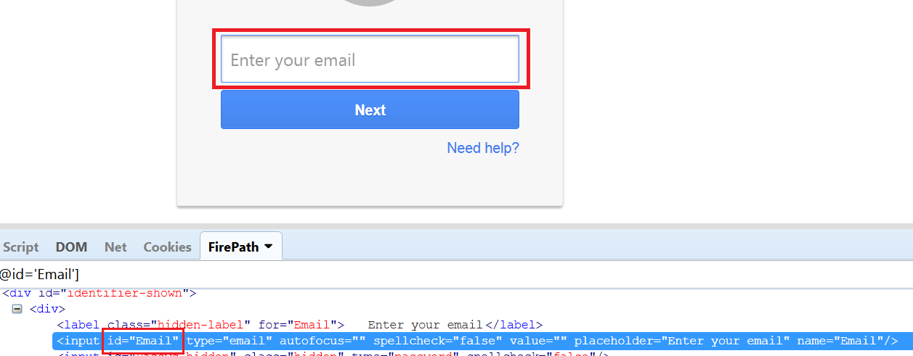
Locator id
The most preferable way to locate an element in the webpage is locating By id. It is always better to identify the object with unique property. Because id is always unique
WebElements username =driver.findElement(By.id(“Email”));

Slide 22
Locator name
If id is not available for any element. Then , next preferred locator would be name.
WebElements username =driver.findElement(By.name(“service”));

Slide 23
Locator class name
There can be multiple elements having the same class name, in that case selenium will perform action on the first matched element
We can also locate an element by using its class name
WebElements username =driver.findElement(By.className(“need-help”));

Slide 24
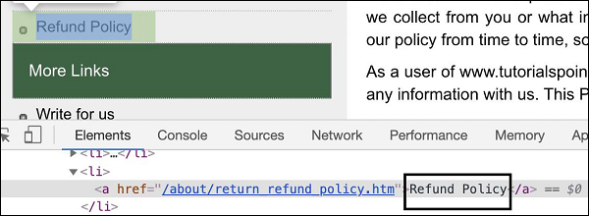
Locator Partial linktext
As it name says, we can use the partial text of link to identify that by using partialLinkText locator.
WebElements username =driver.findElement(By.partialLinkText(“Refund”));

Slide 25
Locator Xpath
Xpath is known as xmlpath it is used to identify the elements in an webpage
Xml and Html having same parent SGML(Standard generalized markup language)
When no attributes are there to find an element by using Xpath we can locate it
Types of Xpath
1.Absolute Xpath
2.Relative Xpath
Absolute Xpath
It generates the path from the root node of the document and usually starts with single slash (/). Root node starts from tag html
(" /html/body/div[2]/header/div[1]/div/ul/li[1]/span"))
Relative Xpath
It can generate path at any position in the document and use double slash(//) to start.
("//input[@name='q']"))

Slide 26
Locators types
Method | Syntax | Description
By ID | driver.findElement(By.id (<element ID>)) | Locates an element using the ID attribute
By name | driver.findElement(By.name (<element name>)) | Locates an element using the Name attribute
By class name | driver.findElement(By.className (<element class>)) | Locates an element using the Class attribute
By tag name | driver.findElement(By.tagName (<htmltagname>)) | Locates an element using the HTML tag
By link text | driver.findElement(By.linkText (<linktext>)) | Locates a link using link text
By partial link text | driver.findElement(By.partialLinkText (<linktext>)) | Locates a link using the link's partial text
By CSS | driver.findElement(By.cssSelector (<css selector>)) | Locates an element using the CSS selector
By XPath | driver.findElement(By.xpath (<xpath>)) | Locates an element using XPath query

Slide 27
Test case
The test case is an in-details document that includes all possible inputs such as positive and negative, and the navigation steps. These are implemented during the testing process to check whether the software application is performing the task for that it was developed or not.
Test scenario
It is a detailed document of test cases that cover end to end functionality of a software application in liner statements. The test scenario is a high-level classification of testable requirements. Before performing the test scenario, the test engineer needs to consider the test cases for each scenario.

Slide 28
Test scenario
Module name | Test scenario id | Test Scenario | No of test case
Sign in module | Ts_001 | To check user able to sign in a page | 1
Purchase a product | Ts_002 | To check user able to purchase a product | 2

Slide 29
Test case
Test case ID | Test scenario | Test case | Pre condition | Test step | Test data | Expected result | Actual result
Tc_001 | Ts_001 | User select sign option and enters valid username and password | User need a valid email account | Enter username Enter password | Valid username Valid password | It should display a successful sign page | It is displayed a successful sign page
Tc_002 | Ts_002 | User select search icon Enter product name | User need a valid email account | Enter a product and name select search icon | Valid product name | It should displays the product result | It is displayed the product result
Tc_003 | Ts_002 | User enters a valid address And click on submit option | User need a valid email account | Enter a valid address | Valid address | It should display your order is conformed | It is displayed your order is conformed

Slide 30
Jira tool
Jira it is used for project tracking and issue tracking tool
Jira is not an open-source software tool used for managing project tasks, issue tracking and other issues related to software and mobile applications.
It is a platform-independent tool; that can be worked with different types of operating systems.
As we know, Jira is an issue tracking platform, so it is used by development and technical support teams to get work done faster.
Jira Software provides planning and roadmap tools so teams can manage stakeholders, budgets, and feature requirements from day one.

Slide 31
Types of issues
Epic
It represents over all project or big project it is known as parent issue
Story
Smallest unit of work that needs to be done
Task
Work that needs to be done
Bug
Stops the functionality of the product
Subtask
Piece of work that is required to complete a task

Slide 32
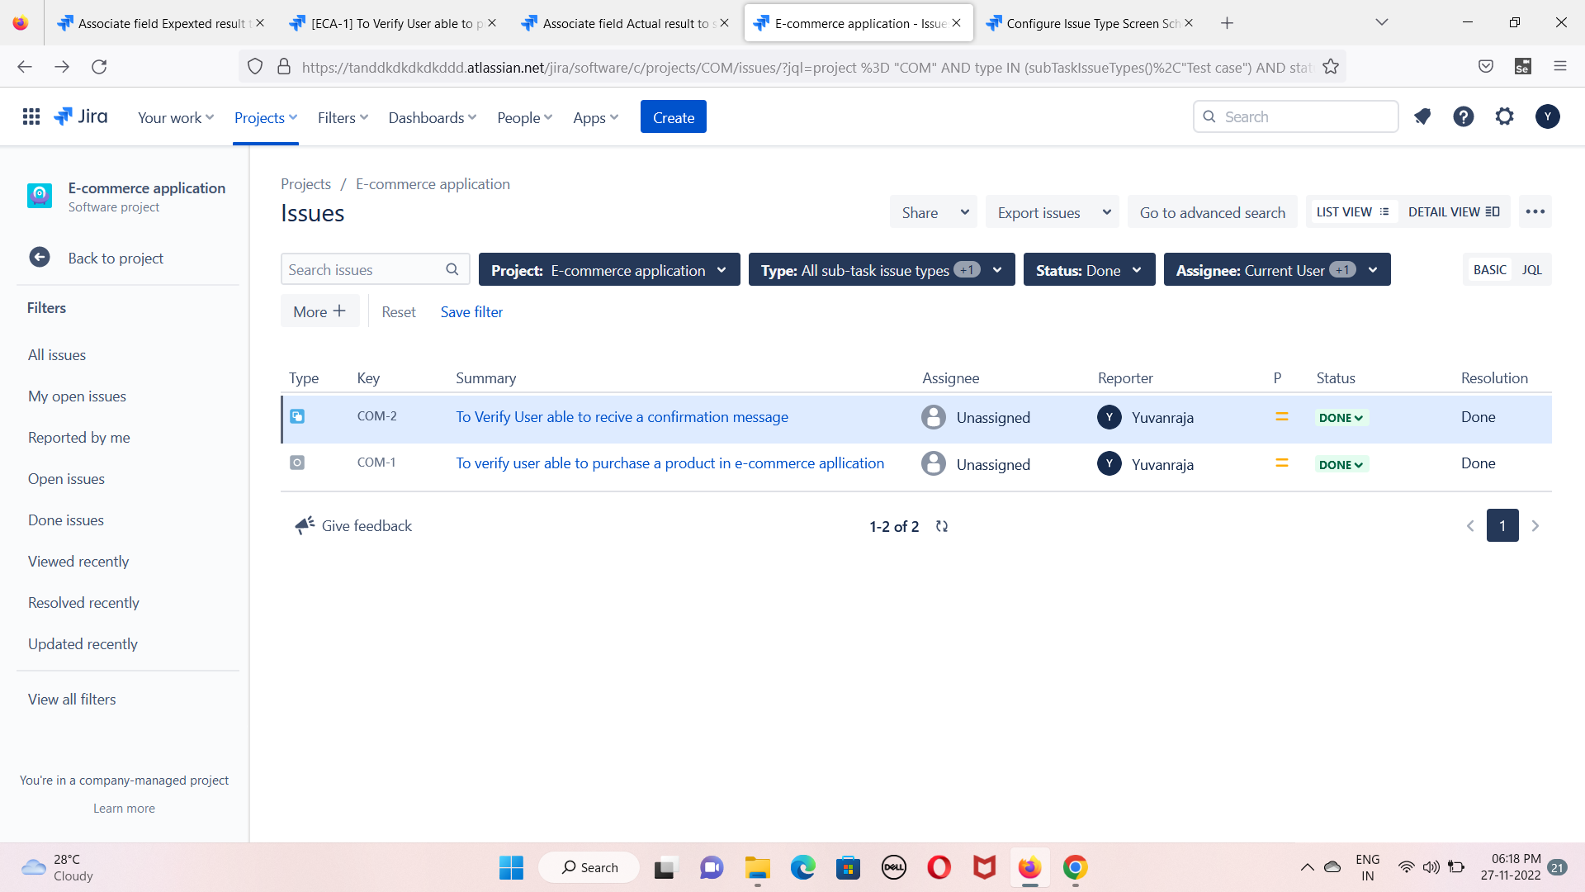
Test case management

Slide 33
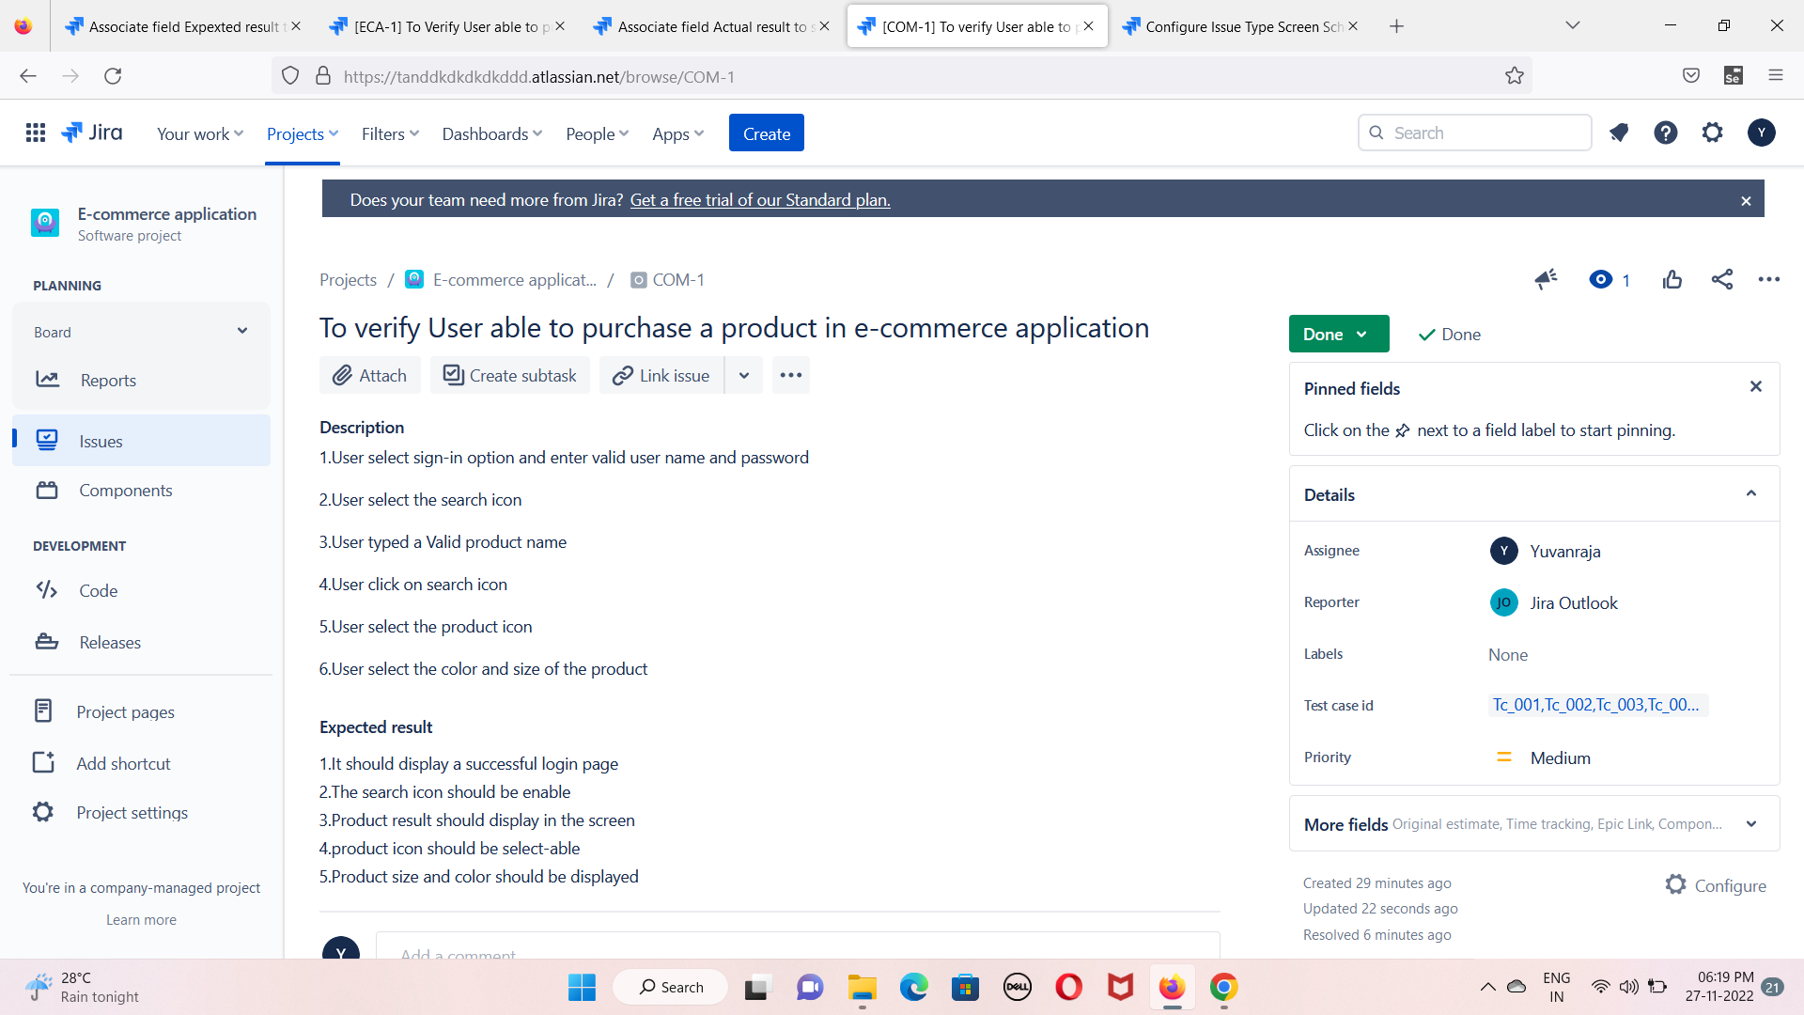
Task issue

Slide 34
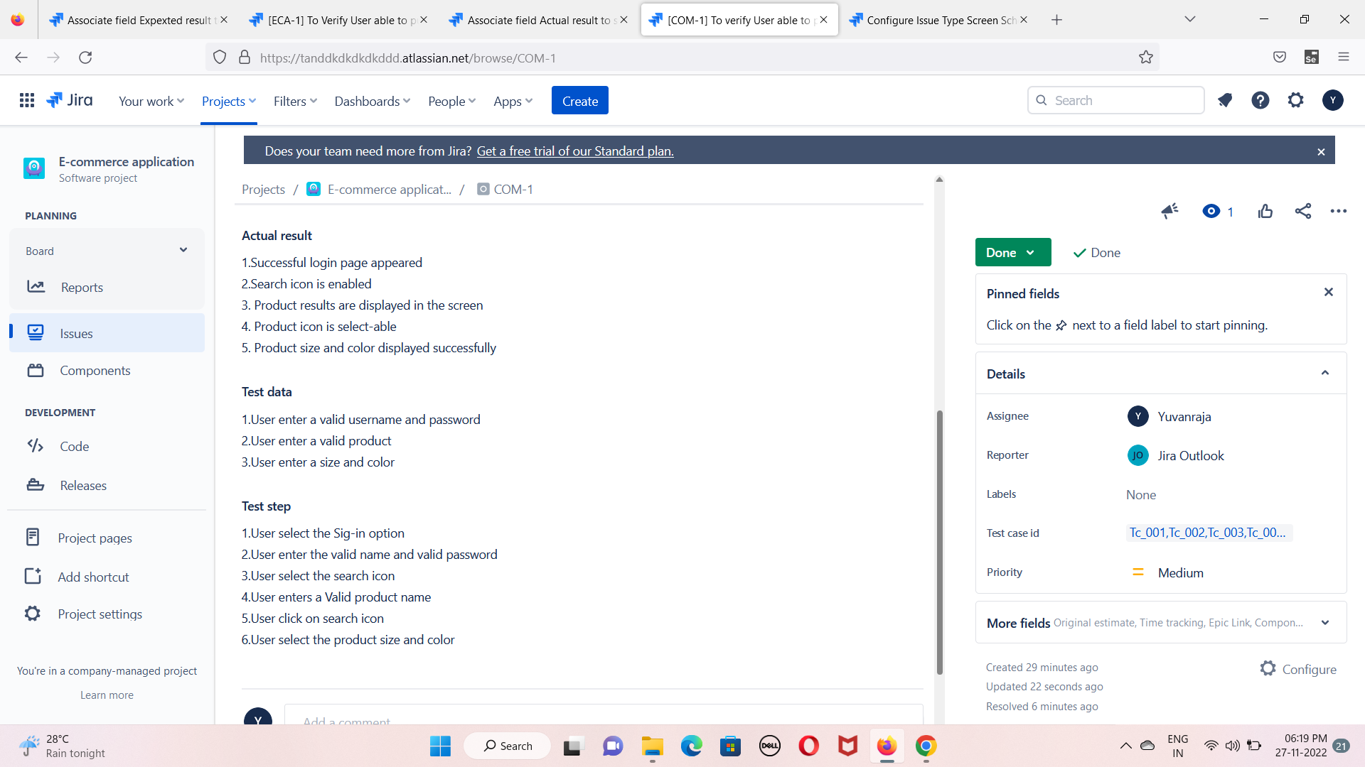
Expected and actual result

Slide 35
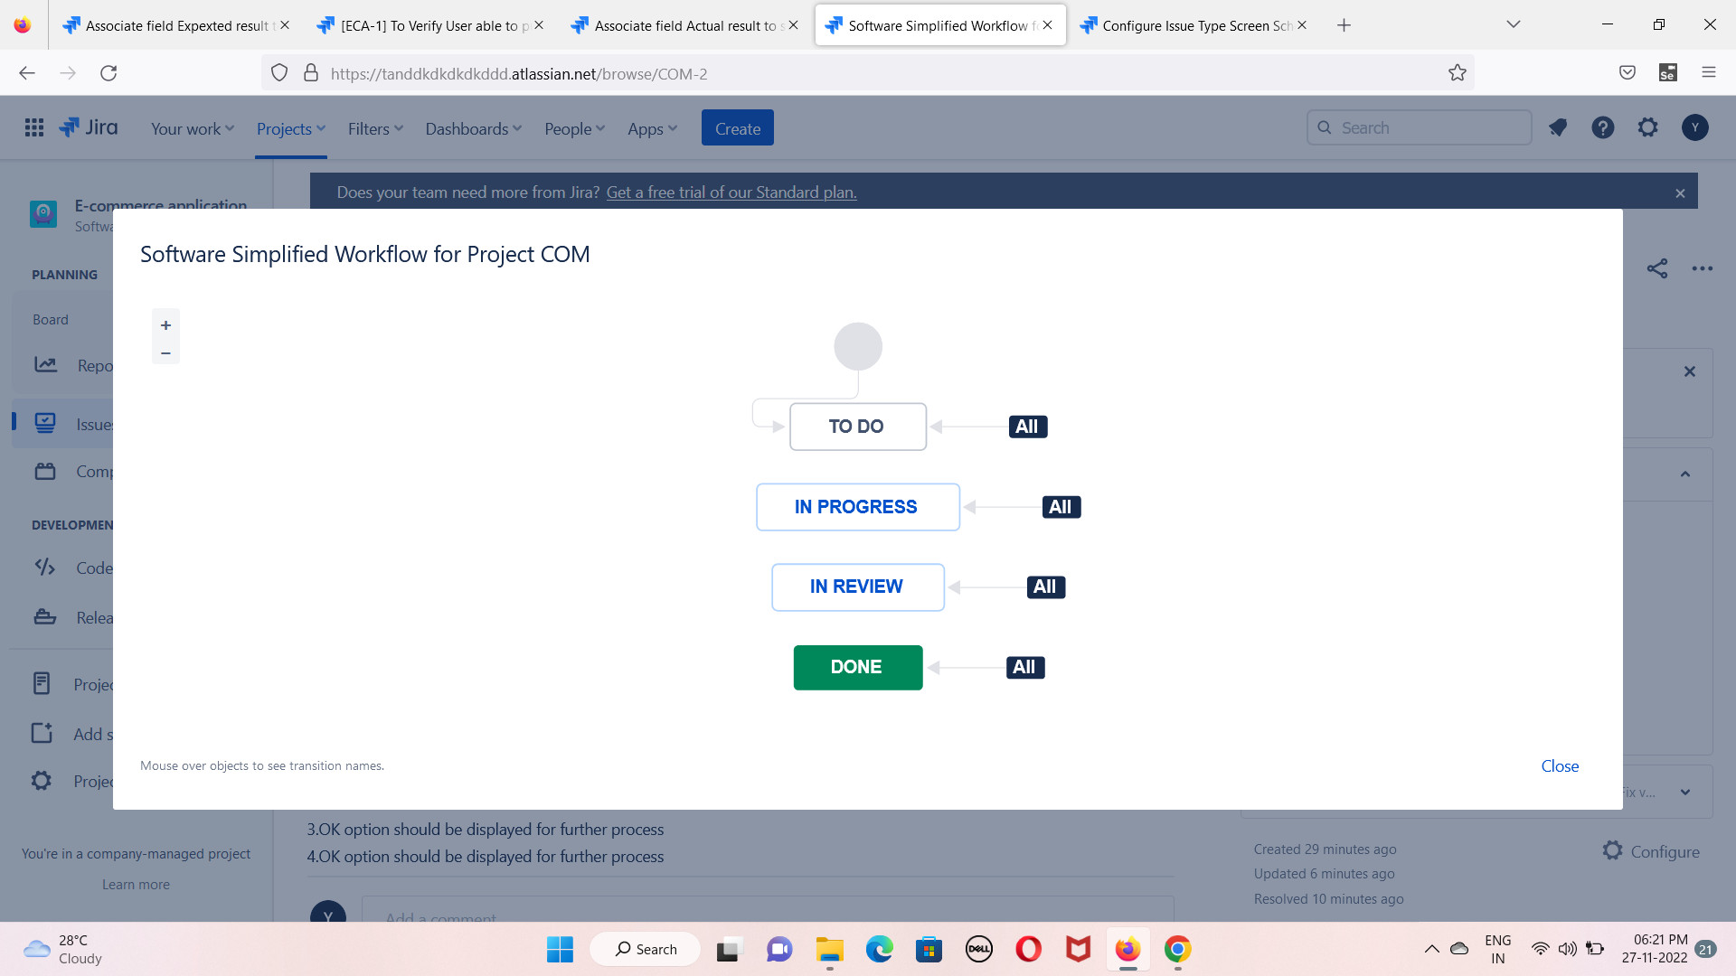
Workflow

Slide 36
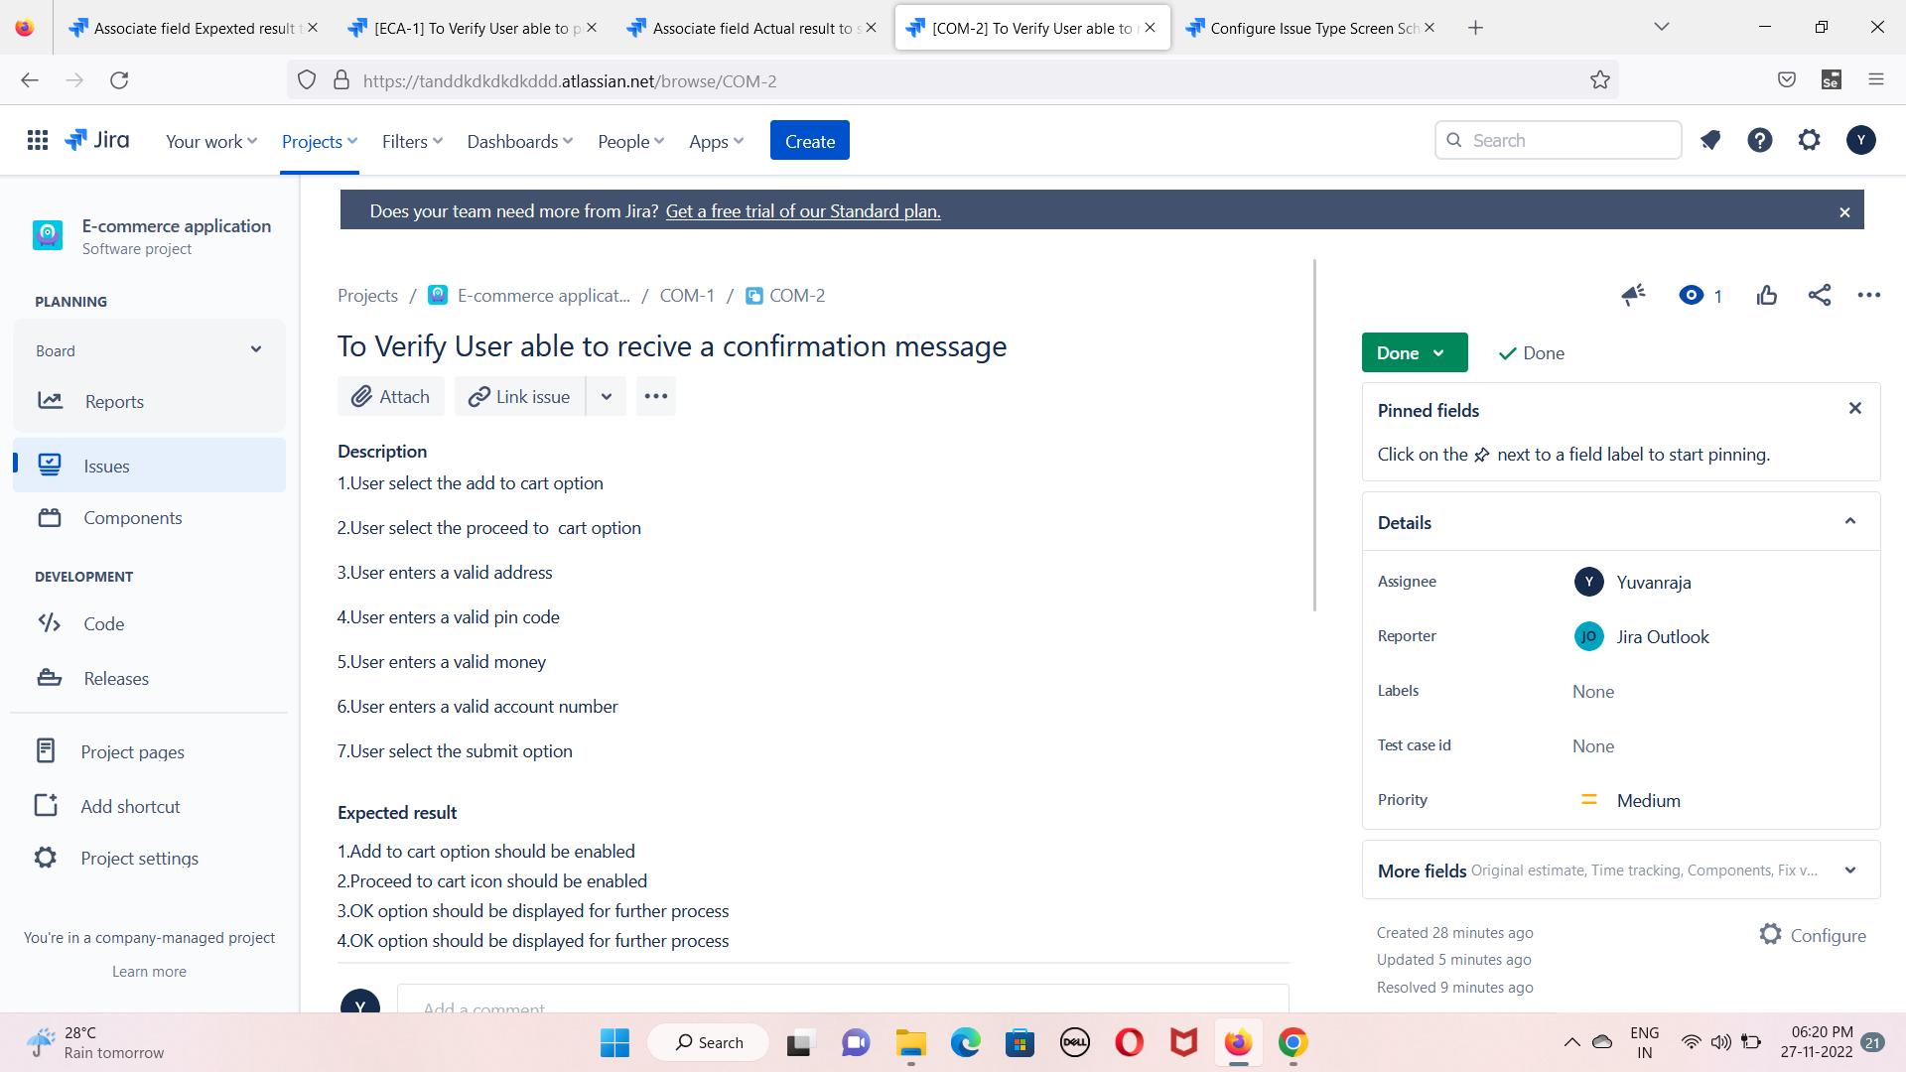
Sub task

Slide 37
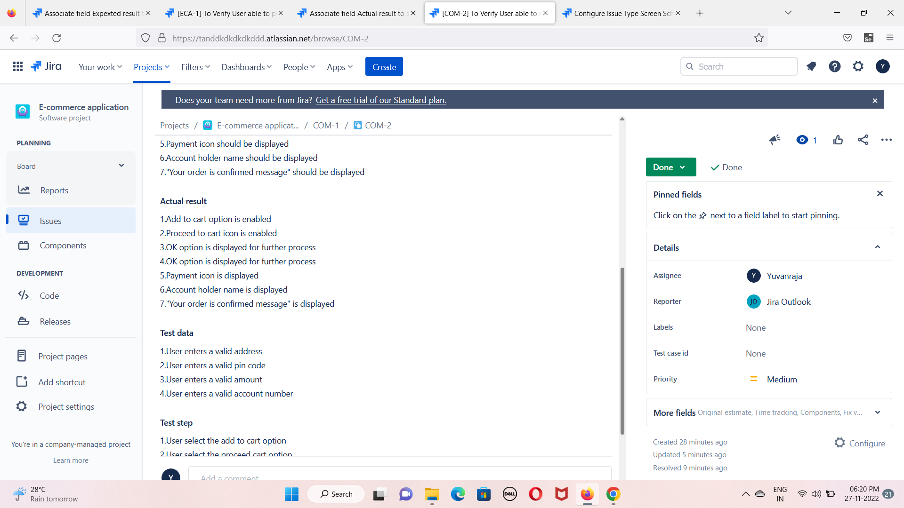
Expected result and actual result

Slide 38
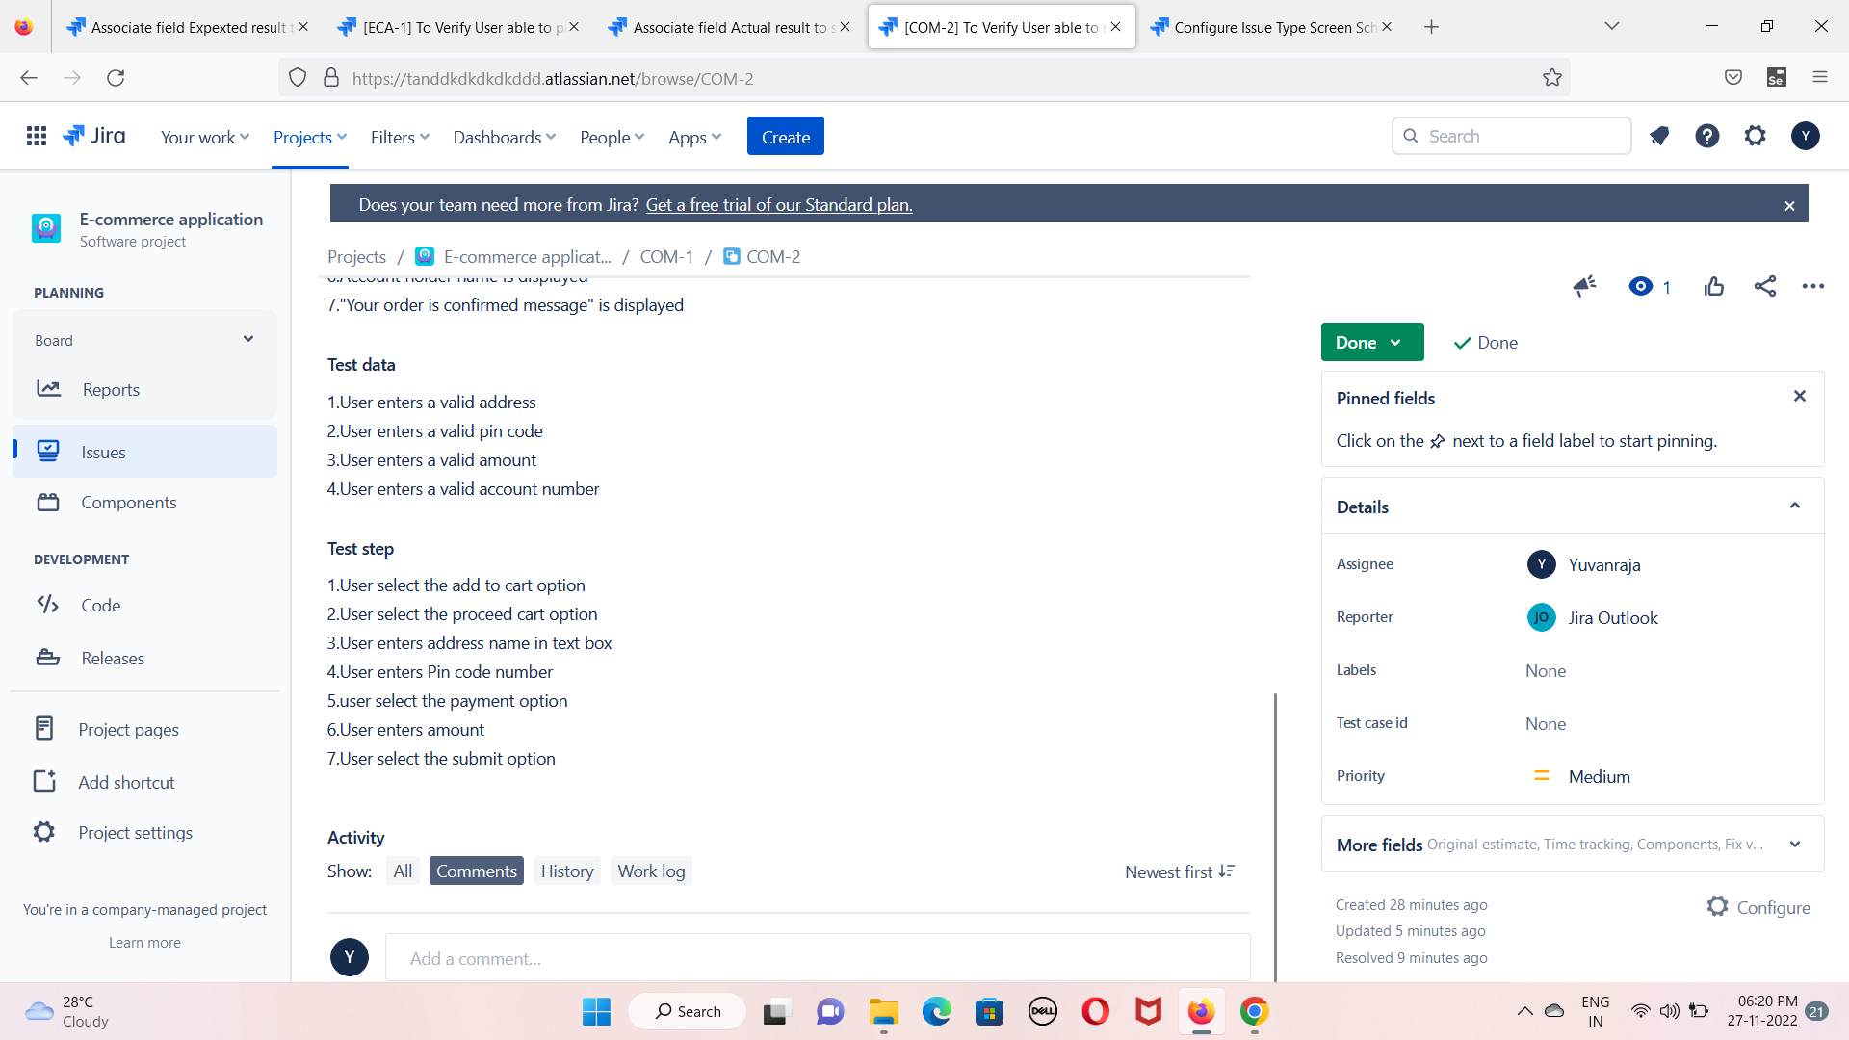
Test data and test step

Slide 39
Workflow

Slide 40
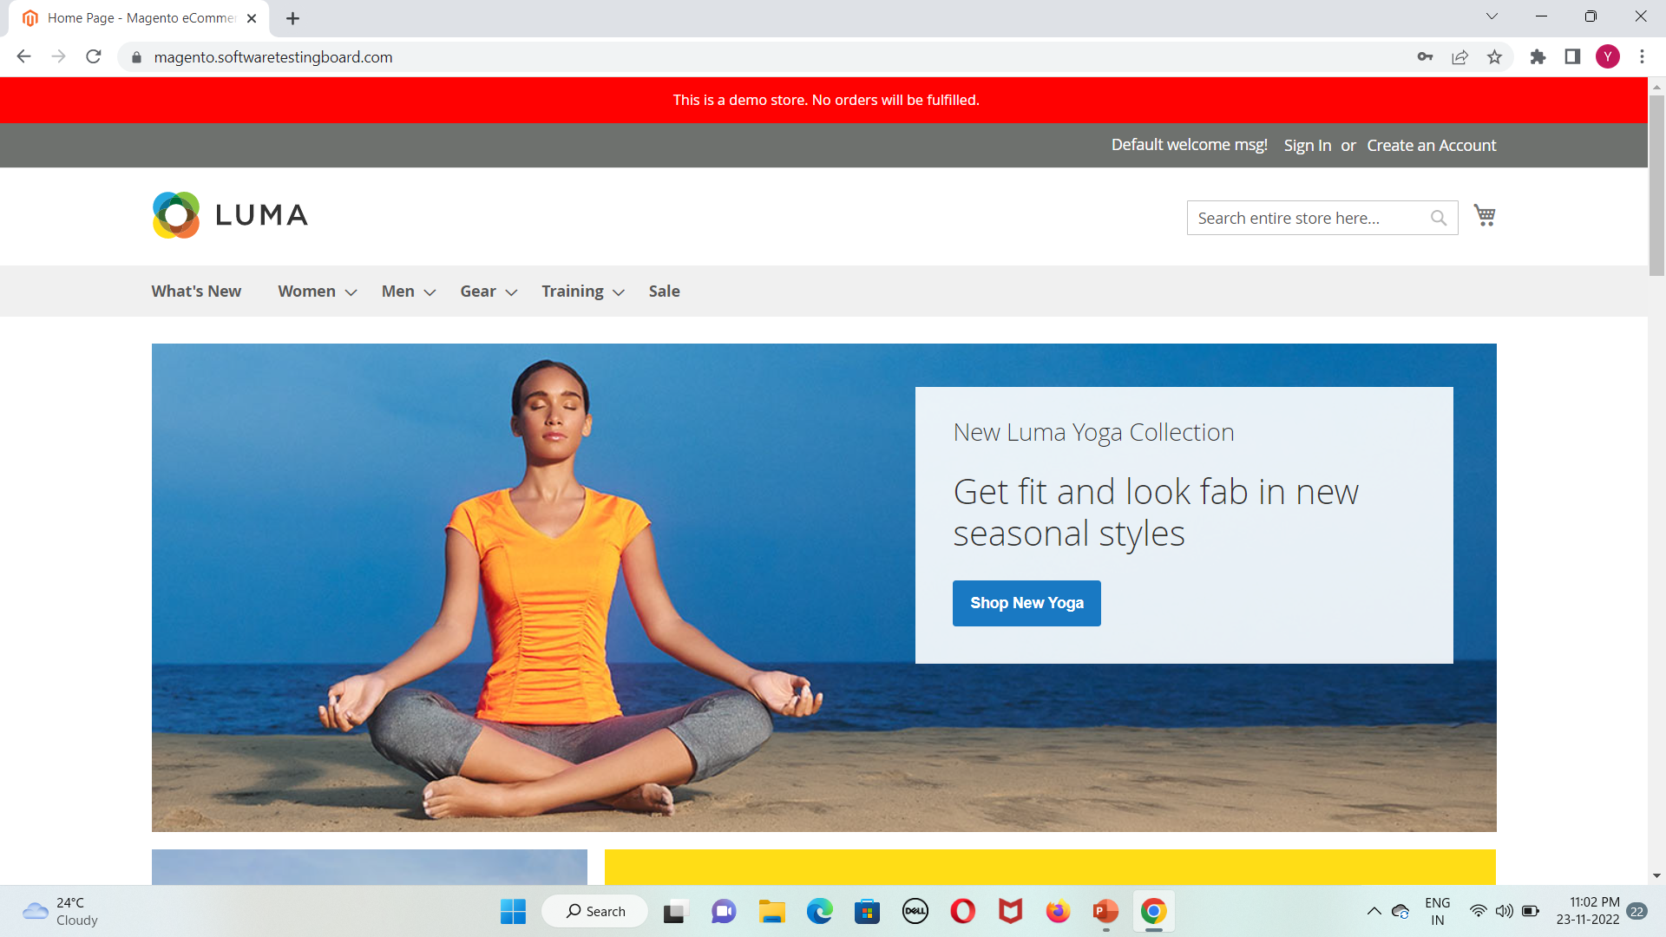
Project Home page

Slide 41
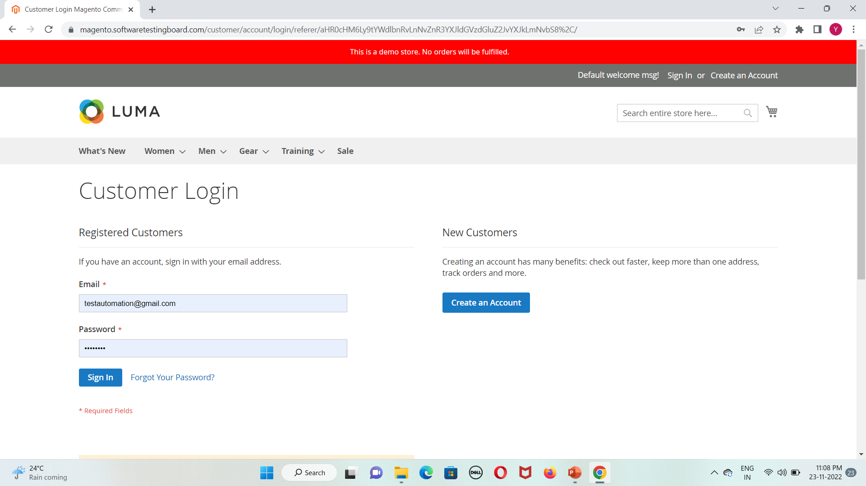
Sign module

Slide 42
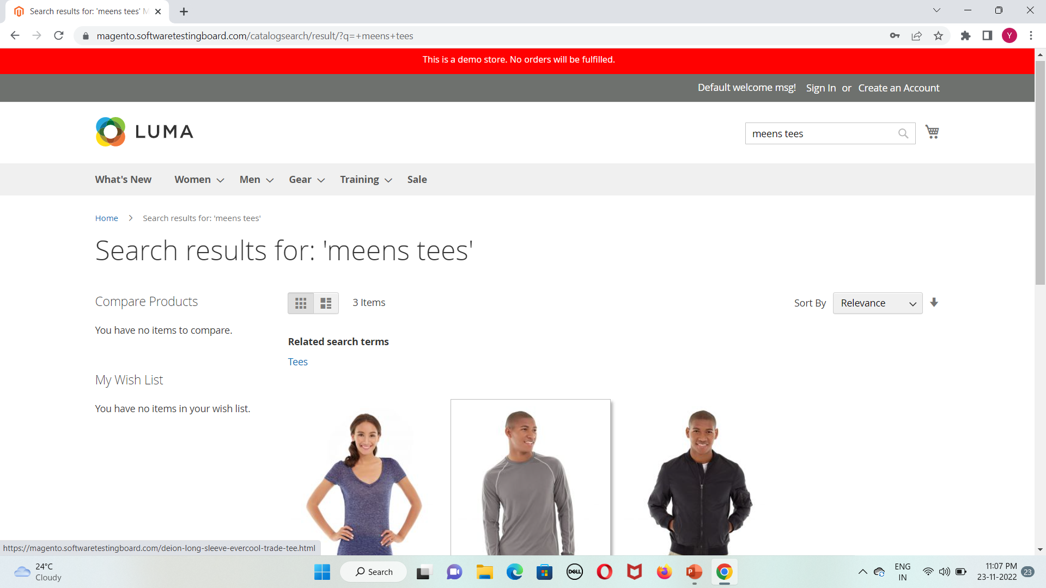
Searching of product name

Slide 43
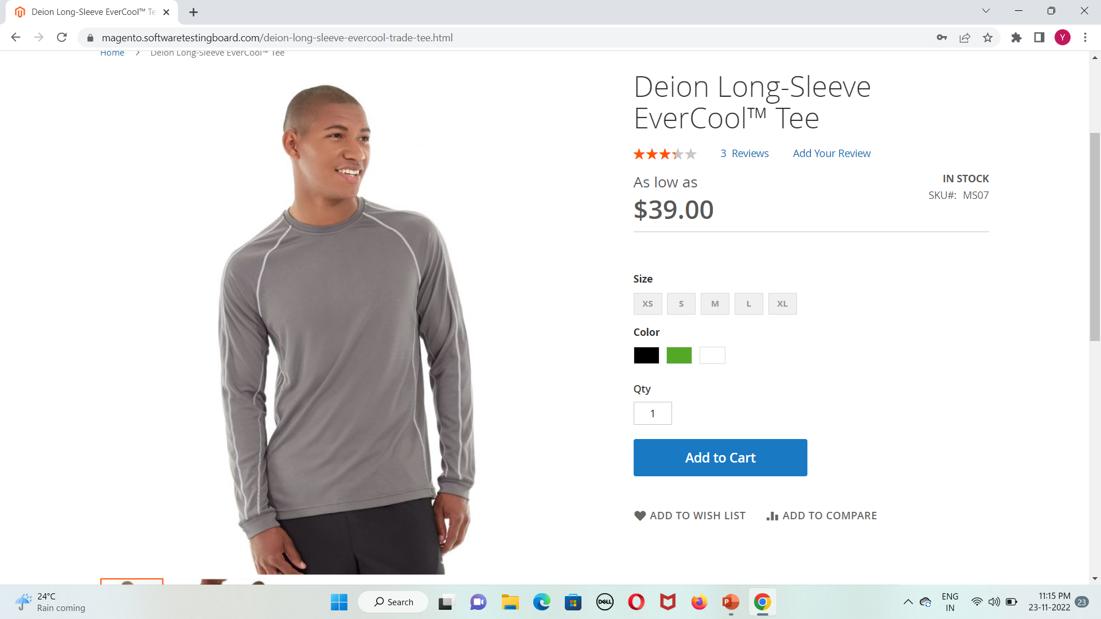
Selection of product

Slide 44
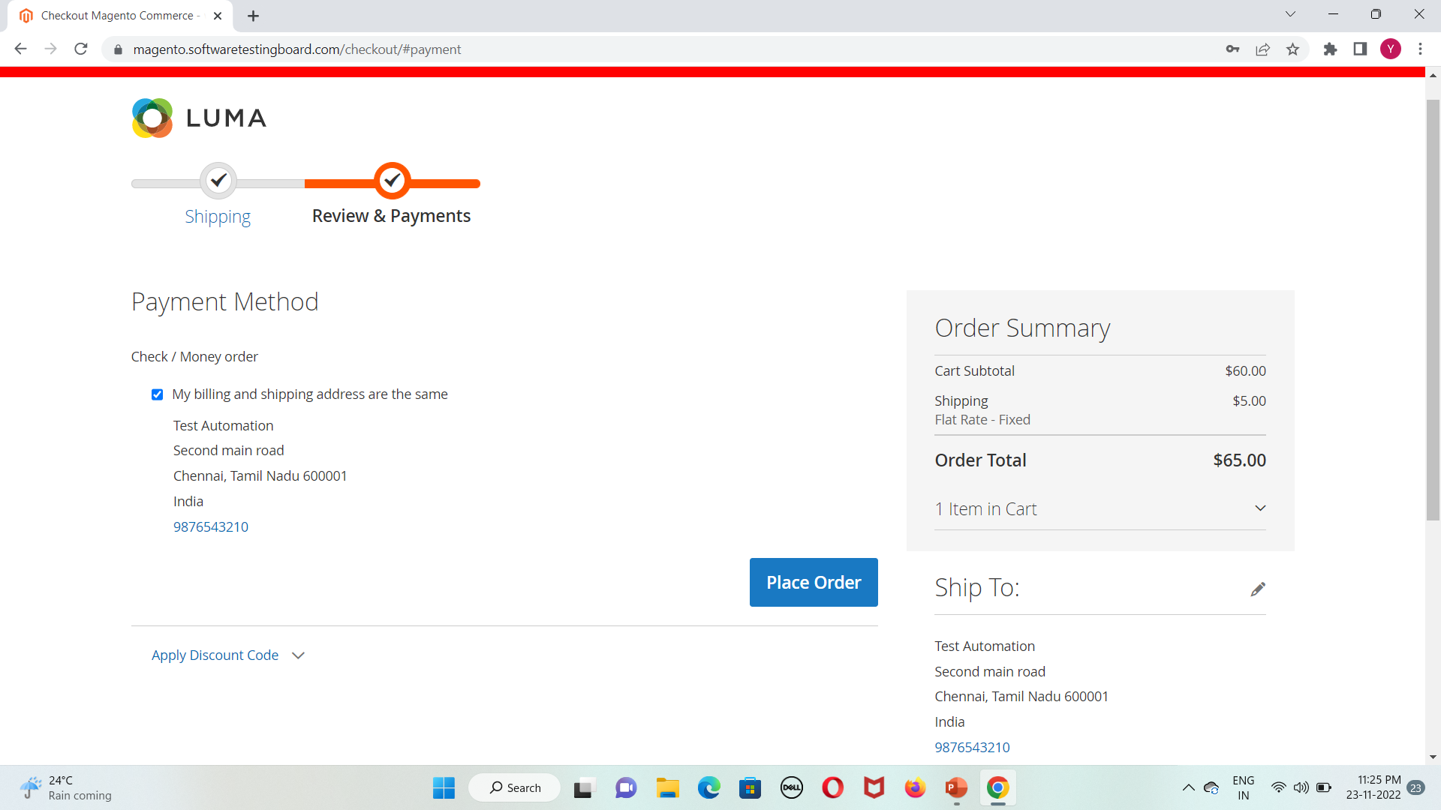
Payment process

Slide 45
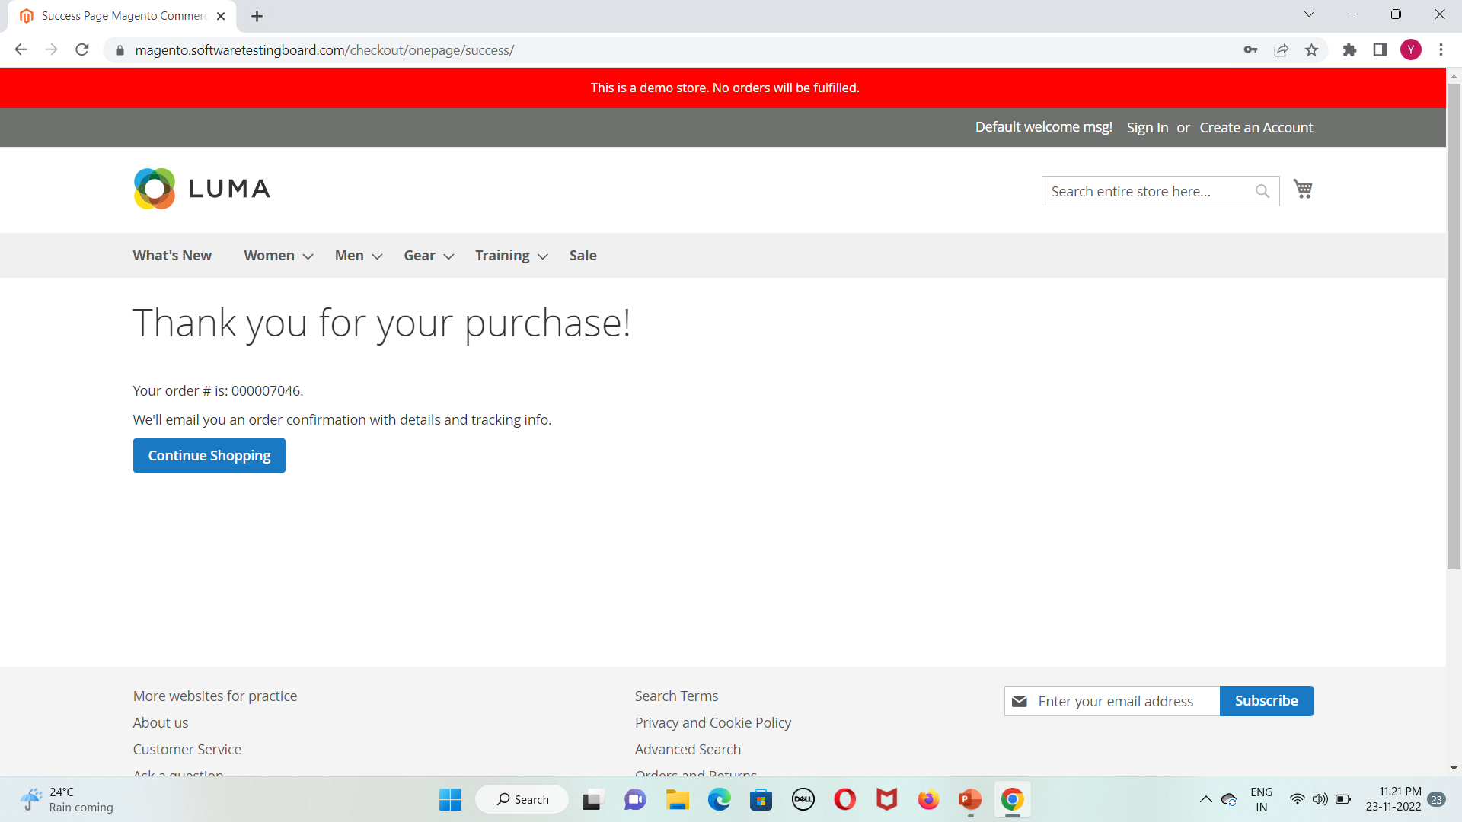
Receiving a confirmation message

Slide 46
Advantages of Selenium tool
Selenium IDE worked only in Mozilla while RC and WebDriver work in IE, Chrome, Firefox, Opera, Safari and many other browsers.
Selenium is an Open Source Software.
Selenium supports various programming languages to write programs (Test scripts)
WebDriver test cases execute faster when compared to the other tools of the Selenium suite.
It is very easy to locate web elements with the help of an ID, class, name, XPath, etc.
Selenium WebDriver supports automation of test scripts across the various devices, which can be BlackBerry, Android, and iPhones.

Slide 47
Drawbacks using software
Finding the element by using the locator sometimes not all the time we may not find any attributes names
So that time we can use Xpath to find the locator of the element
But even though when we mentioned correct locator also sometimes it will throw an exception to avoid that
In this project I have implemented JavaScript executor by using the executeScript method we can perform action on the web element
For scroll down a page or scroll up a page is also easily can implement by using executeScript method.
js.executeScript("window.scrollBy(100,0)", "");
js.executeScript("arguments[0].click();", nextButton);

